Slide 1
NATIONAL DAYS What do you know?
# | The country celebrates… | COUNTRY
1 | … its independence from Britain
2 | … its Queen‘s birthday
3 | … its patron saint
4 | ... its unification with two official languages
5 | …the day when Britain took possession

Slide 2
AUSTRALIAN NATIONAL DAYS

Slide 3
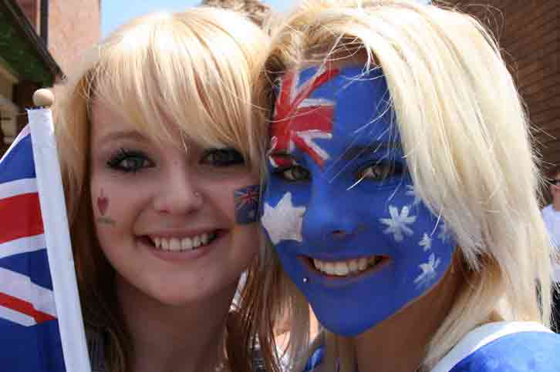
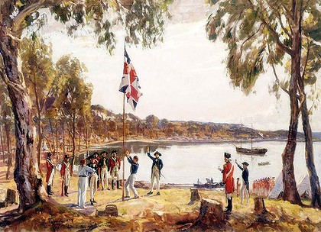
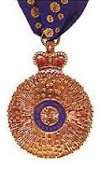
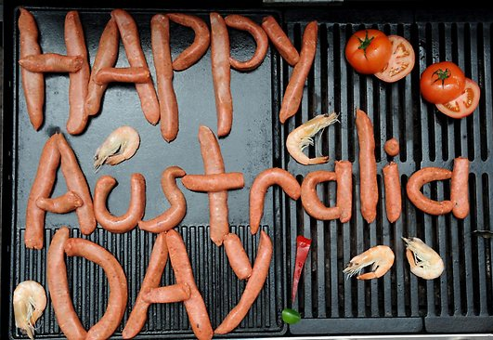
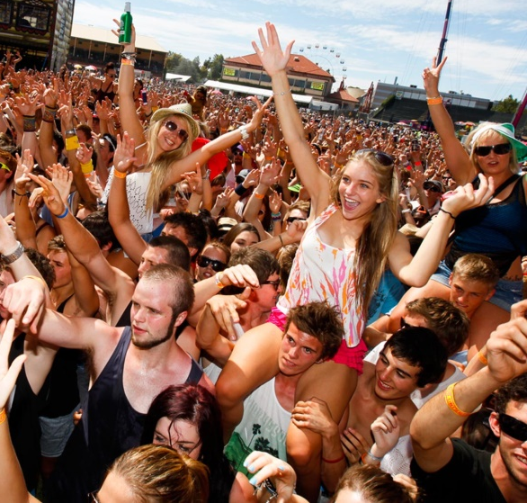
Australia Day
WHEN is it?
26th January
http://www.readengage.com
WHY is it significant?
commemorates the arrival of the First Fleet
http://beinbalance.wordpress.com
http://www.army.gov.au
WHAT happens?
ceremonies (citizenship & award)
musical festivals
picnics, barbeques & luncheons
sporting contests
http://www.smh.com.au
http://www.wordstorm.com.au
http://www.peergroupmedia.com

Slide 4
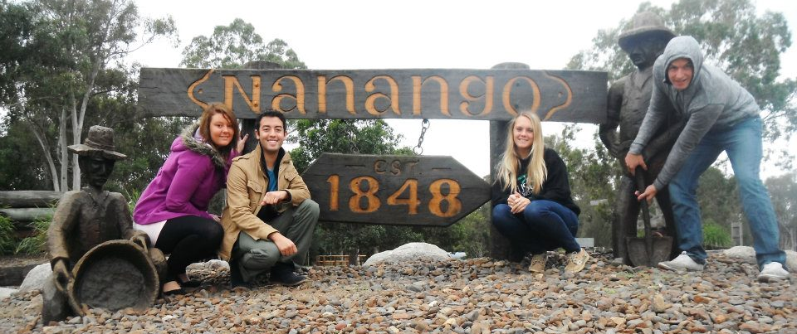
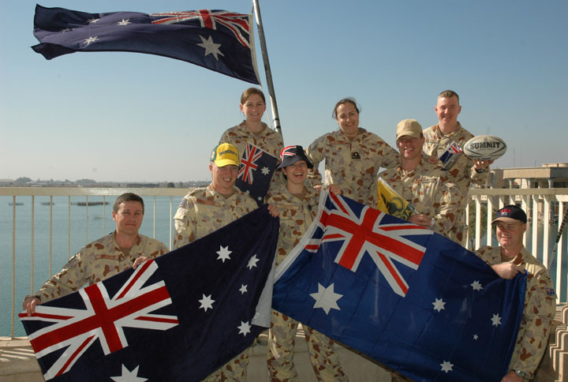
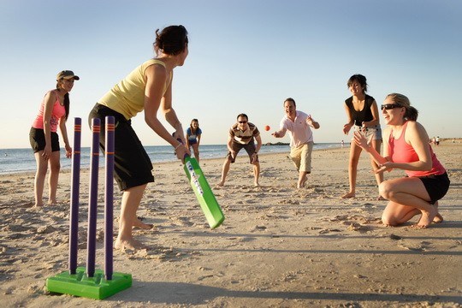
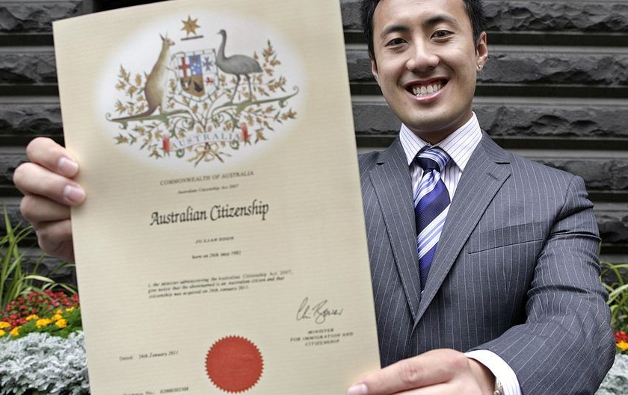
Australia Day
WHERE is it celebrated?
big cities & small towns
beaches & outback
WHO is involved?
Australians
New-Australians
Foreign Tourists
http://blogs.queens.edu
http://notanothernewenglandsportsblog.blogspot.com
http://nepaliaustralian.com
http://www.abc.net.au/

Slide 5
What does Australia Day mean to different people?
https://twitter.com
http://www.ruthdesouza.com
http://www.ruthdesouza.com/
http://travisbacon.com/

Slide 6
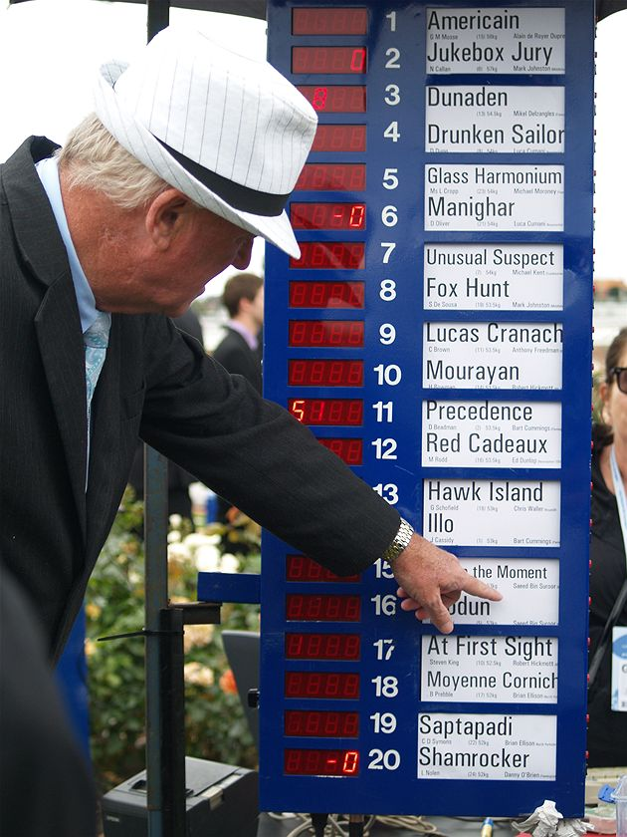
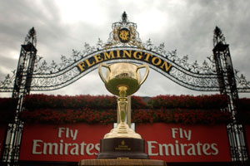
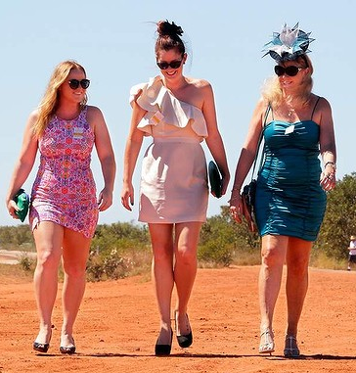
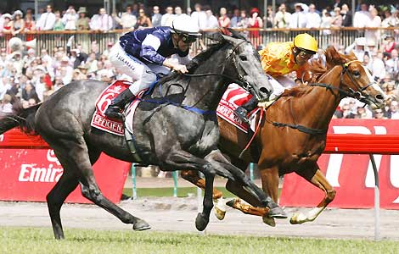
Melbourne Cup
WHEN is it?
1st Tuesday in November
WHY is it significant?
most-popular sporting event in Australia
http://www.abc.net.au
http://brisbane.jollypeople.com
http://www.races.com.au
WHAT happens?
Melbourne Cup Day
official betting
workplace sweepstakes
workplace luncheons
sporting contests
http://www.smh.com.au/
http://www.smh.com.au
http://www.smh.com.au

Slide 7
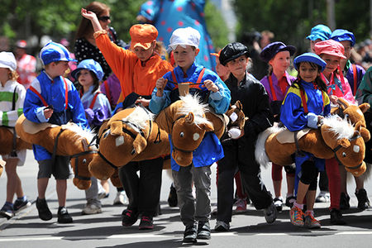
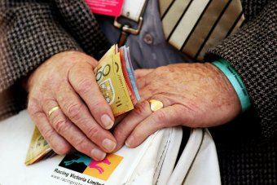
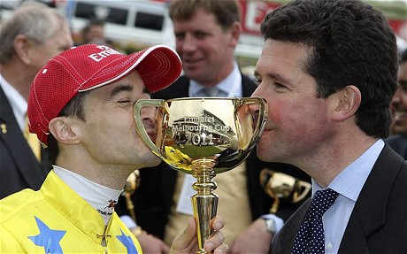
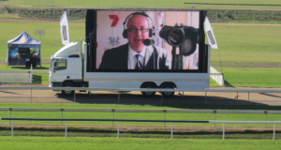
Melbourne Cup
WHERE is it celebrated?
official public holiday in Melbourne
other Australians pause to watch the race
WHO is involved?
horse-racing enthusiasts
occasional punter
http://au.sports.yahoo.com/
http://www.abc.net.au/
http://racesau.com/
http://www.telegraph.co.uk/

Slide 8
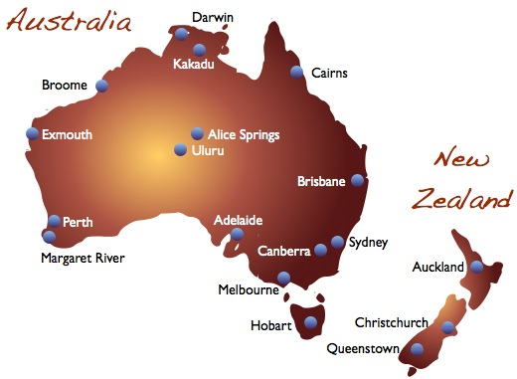
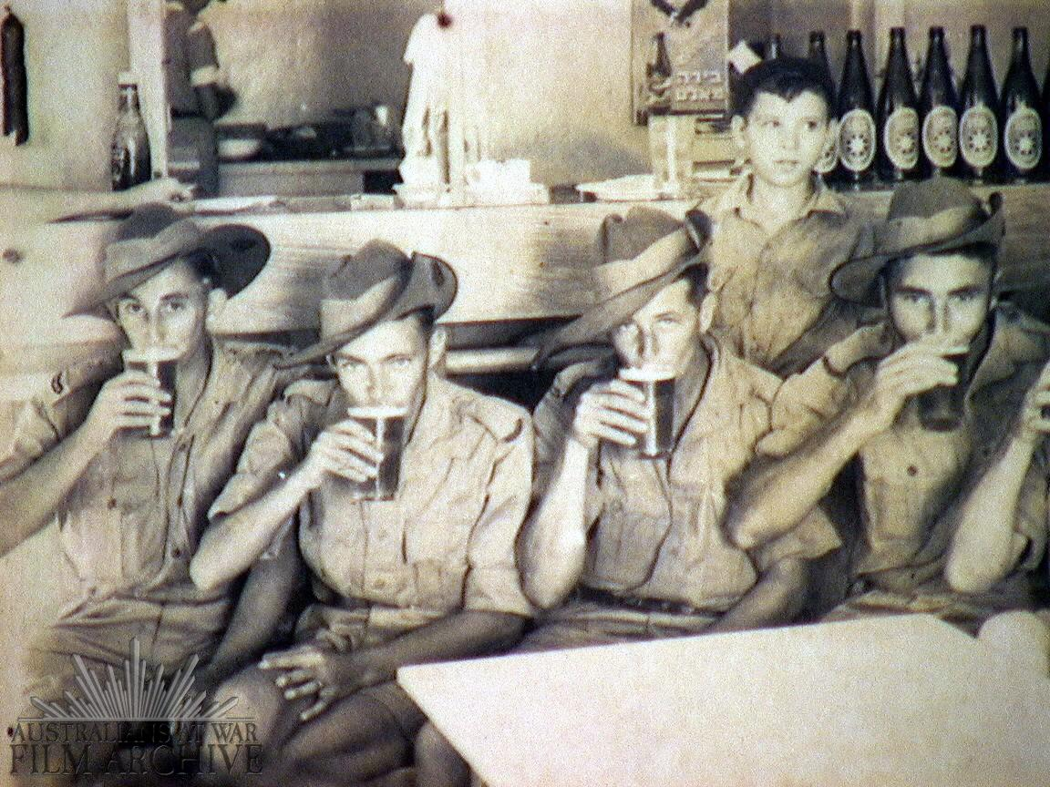
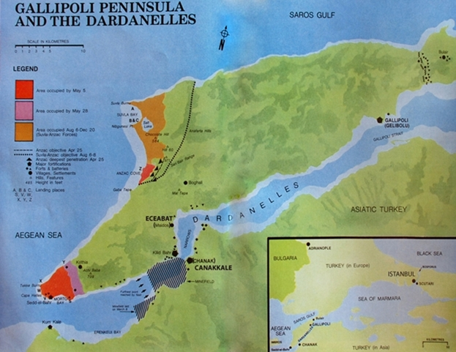
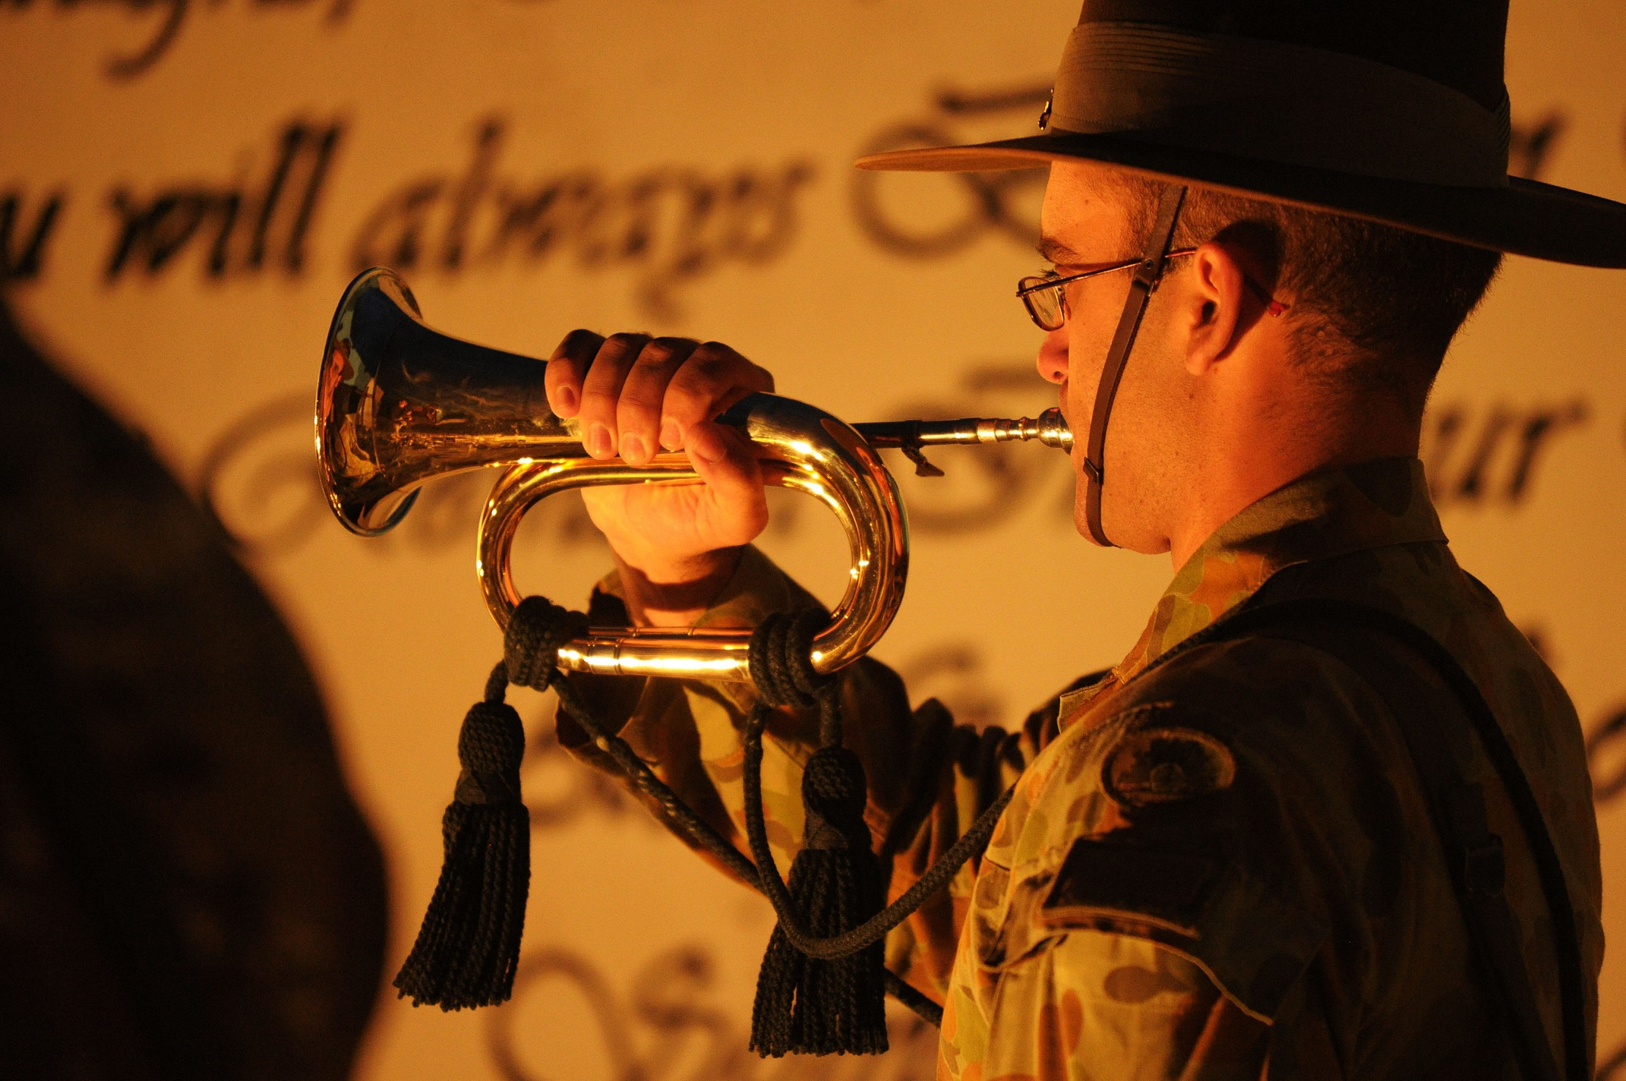
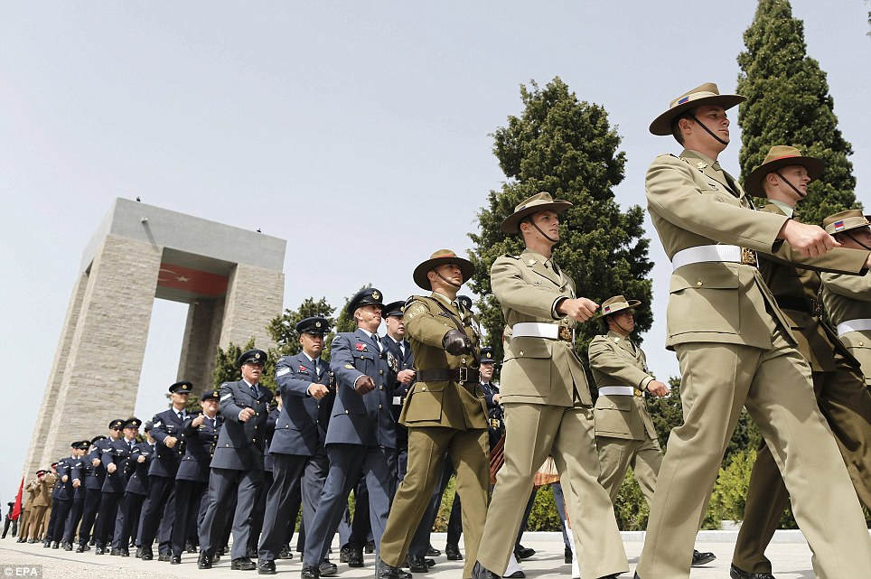
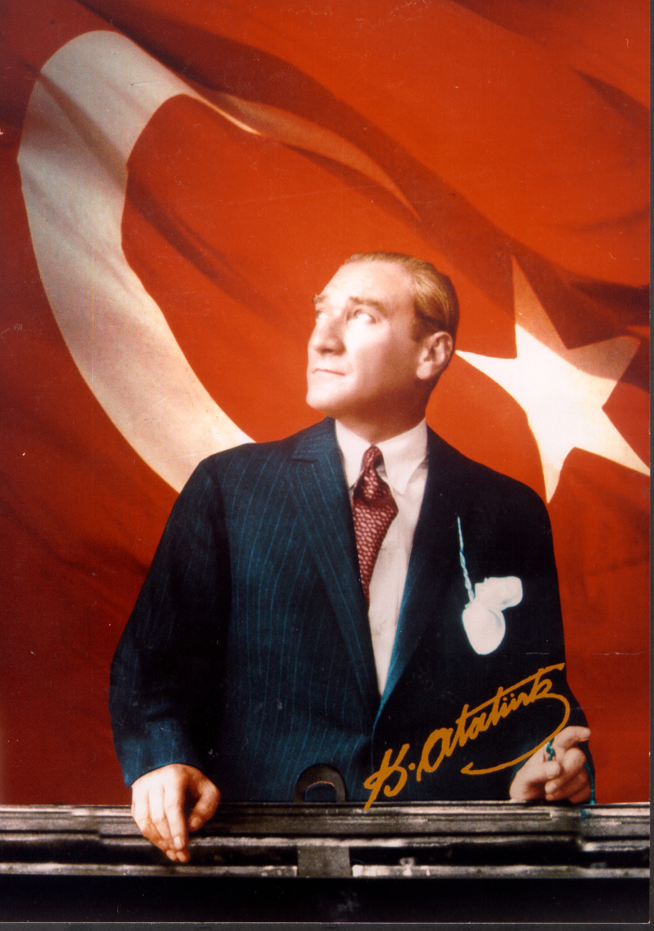
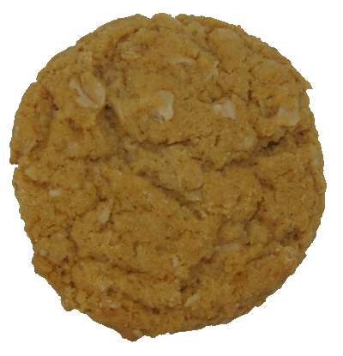
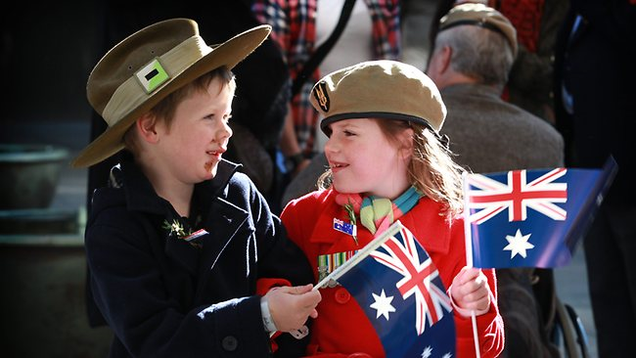
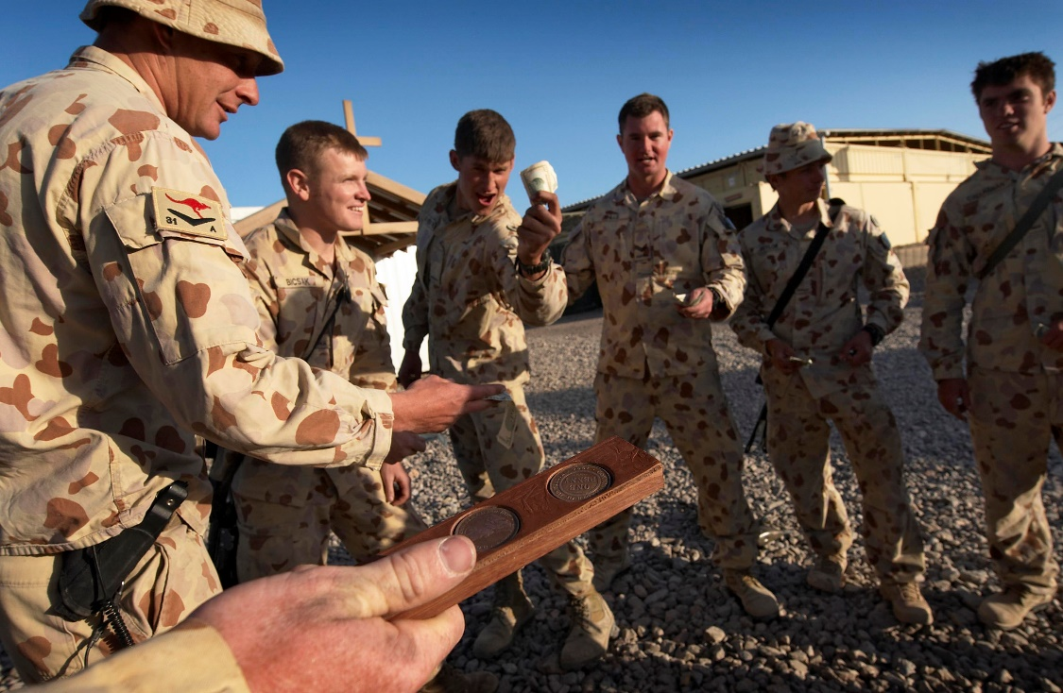
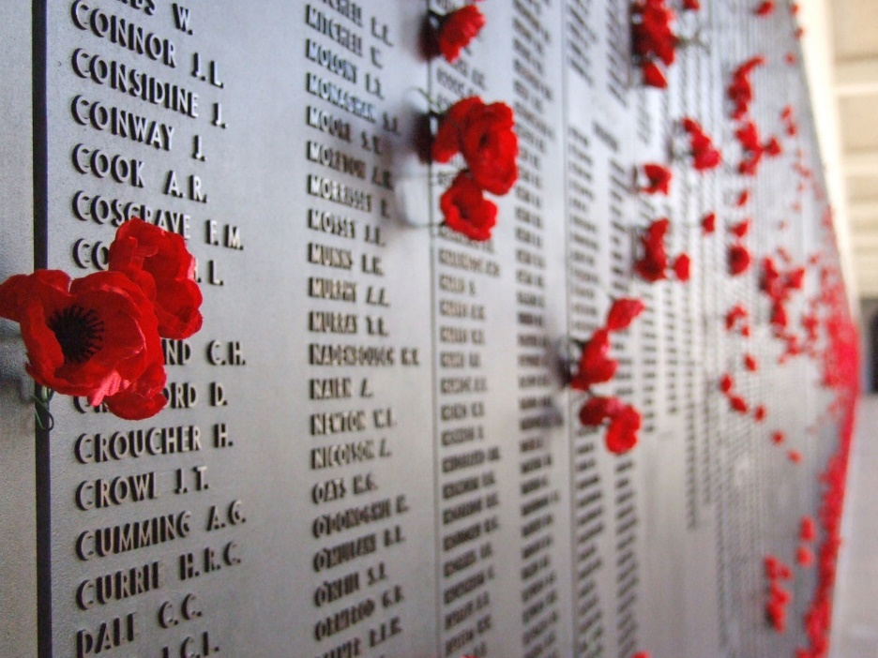

Slide 9
ANZAC Day Reading Comprehension Activity
Individual work. Read the Anzac Day text. Underline unknown vocabulary.
Class work. Clarify unknown vocabulary and complete vocabulary list.
Pair work. Identify the WHEN, WHY, WHAT, WHERE & WHO of the text.
Class work. Report back to the class.

